Slide 1
Prediction of the House Price.
- Prashant Walunj PGA-34

Slide 2
Introduction
Development of civilization is the foundation of the increase in demand for houses day by day. Accurate prediction of house prices has been always a fascination for buyers, sellers, and bankers also.
The real estate market is a standout amongst the most focused regarding pricing and keeps fluctuating.
Prediction is an important part provided by Machine Learning.
In the housing market 2016, the house sold in India was about 80 lakh but the real price according locality and size was about 60 lakh.
As per five-year forecast, estate agents Savills predicted a 3.5% rise for prices in 2022, culminating in an overall 13.1% increase by 2026.

Slide 3
Objective
The main aim is to predict the efficient house pricing for real estate customers with respect to their budgets and priorities. By analyzing previous market trends and price ranges, and also upcoming developments future prices will be predicted.
Sub-Objective
Determining the House Price based on its characteristics.

Slide 4
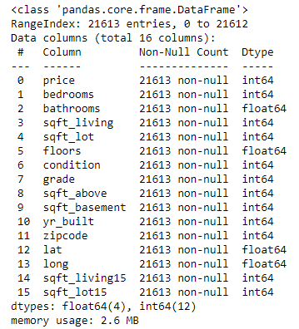
Data Description
This classic dataset contains the price and other attributes of almost 21,613 House entries. There are 16 attributes included in the dataset including the target i.e. price.
Source:-
Dataset downloaded from kaggle.com

Slide 5
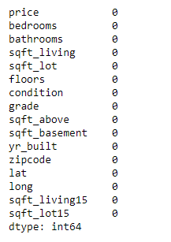
Exploratory Data Analysis (EDA)
1) Checking Null Values
There is no null data in the dataset and the same can also be checked by using data.isnull().any.

Slide 6
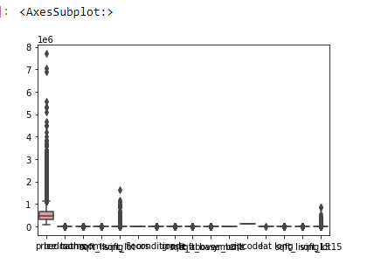
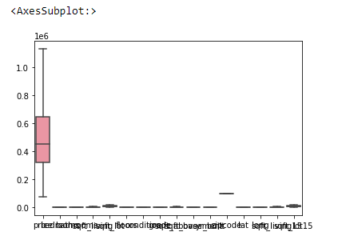
2) Treatment of Outlier using Box Plot
Before Treatment of Outlier
After Treatment of Outlier

Slide 7
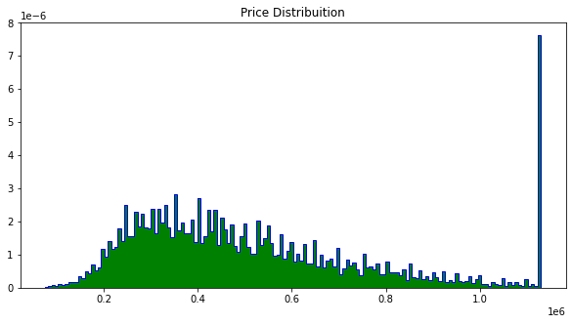
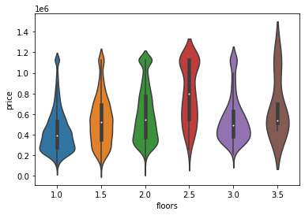
Data Visualisation
See both the distribution of variables and also the relationships between two variables

Slide 8
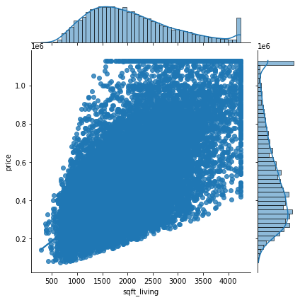
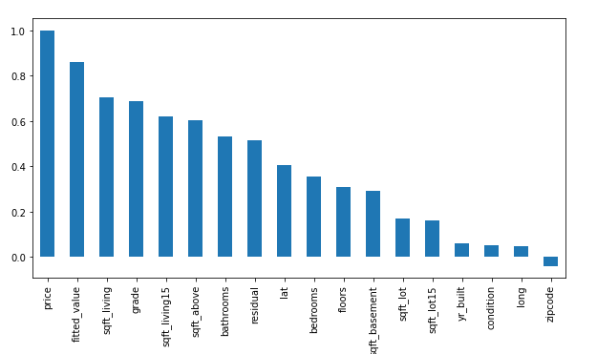
We can conclude that sqft_living, grade, & sqft_living15 features has strong correlation w.r.t price.
Linear relationship between the sqft_living and the price.

Slide 9
Data Partition
The Dataset is partitioned to Two Subset
Dataset
Train Dataset 70%
Test Dataset 30%
By Using Train Data We Build The Model And In Test Data We Check The Performance of The Model.

Slide 10
Model Building
In Model Building We perform Different Types of model.
We Can Check Accuracy On Different Models Which Gives Different Accuracy.
Model Type | Accuracy of Model
Multiple Linear Regression | 73%
Decision Tree | 73%
Random Forest | 82%
KNN | 70%

Slide 11
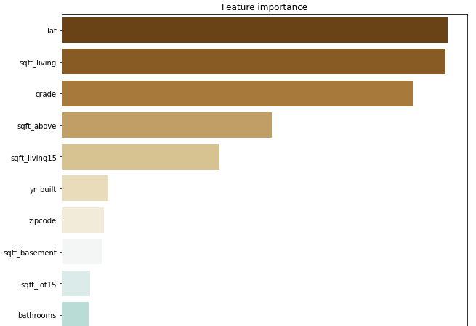
Important variable
Lattitude(Area), Sqft_Living, Grade, Sqft_above has highest impact on House price.
Price is depend on lat, sqft_living, grade, sqft_above, sqft_living15, yr_built.
So, Important variable is to Predict the House Price is lat, sqft_living, grade, sqft_above, sqft_living15, yr_built.

Slide 12
Conclusion
House Price Prediction is very useful to make investments in the real estate.
This study is an exploratory attempt to use four machine learning algorithms in estimating housing prices, and then compare their results.
We are able to Predict accurate 82% Accuracy.
High Influence Variables are
Lat(area)
Sqft_living
Grade
Year_built

Slide 13
Suggestion
Maintain the Grade, Area, Quality of House.
Additional features like air quality and crime rate has to be added in the dataset its an advantage to help predict the prices even better.

Slide 14
Thank You..!

